Slide 1
DEVELOP AN OUTCOME L2
Evidence of Learning Template
NSN:0136629089
Quote Machine
Jack Frear

Slide 2
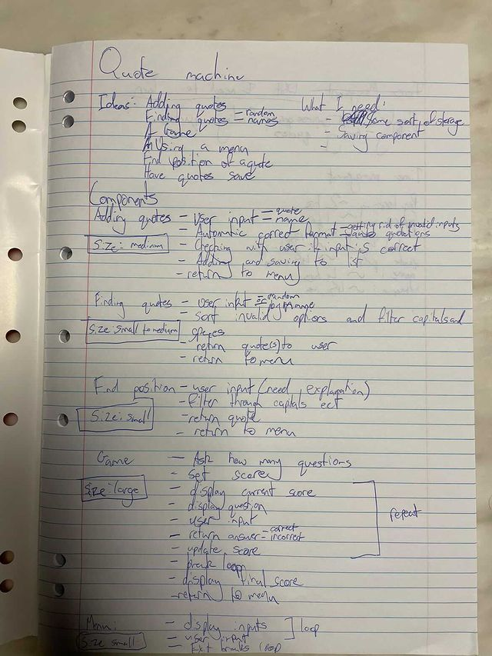
Project management: Setup & Applied
When planning this project I chose to use writing in a book to organise my project as that is what I find to be the most useful of tools for me. Physically writing down what's in my mind down onto paper seems to be the most effective for my working style as it’s more tangible than an online alternative. I thought about using applications like Monday.com and a Trello board and tried them at the start of this project but found them to not suit my style of working. I found that there wasn’t enough ways to visualise my work compared with writing down my ideas as I can freely express what I am trying to visualise.

Slide 3
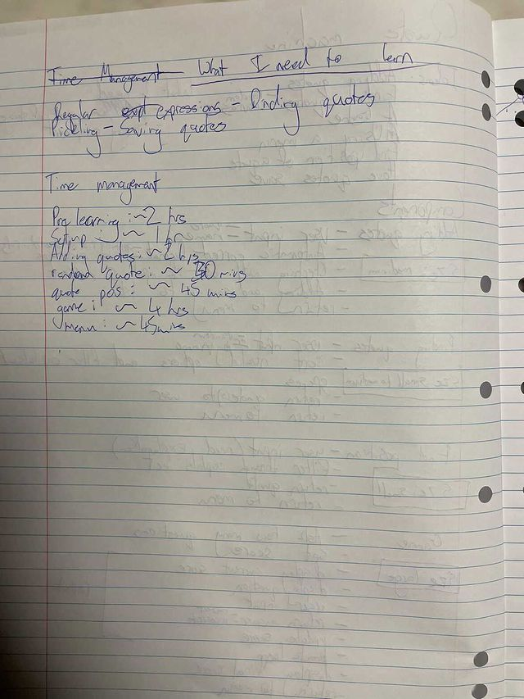
Project management: Setup & Applied
One other way I managed this project was a calendar and dates associated with this project. Since this is a school project that means that it doesn’t have 100% of my dedication and time put into it because of other subjects and responsibilities that come with school. Because of these I had to strategically plan what aspects of the program I need to finish at certain times to finish with enough breathing room so that I can make changes and additions that cannot be planned.

Slide 4
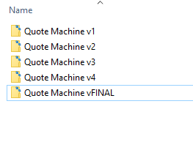
Project management: Setup & Applied
I set up a version control system at the start of this project so I can be sure that if I make any changes that break my program I can always fall back on the previous stable version that was saved to figure out what the problem is. I also made sure to take screenshots as well on the very slim chance that my files were lost somehow or corrupted (which didn’t happen luckily)

Slide 5
Decomposing outcome
How I broke up the project:
Find out specific techniques needed for the project to function (eg: regular expressions and pickling) and to learn how they are applied before starting to apply them the project.
List specific components that are needed for the project and break them up into smaller steps (eg: adding quotes breaks into menu, making sure its the correct format ect.)
Set relative sizes for components in the project so I efficiently use my time and allocate the correct amount for each component .
Set the rough amount of time I think is need for each component in the project.

Slide 6
Decomposing outcome: Adding Quotes
This component is where the main idea for this project started. When looking at this component the most important parts for this component to function and the entire project is how quotes are added and how they are saved. I decided to choose to use a list for the storage of the quotes as it was ordered and changeable, both attributes are needed for this project and the changeable part specifically for the addition of quotes. I also needed a way to save these newly added quotes after the program finishes so that the new quotes will be a part of the next time it runs. The way I solved this problem is by using pickling. The reason I chose to use pickling is that it is stored in an external file which can be changed so is perfect for storing the quotes and that it is stored in binary which saves space on the computer that it runs on. With the main problems solved the component is broken up into: Asking for a user input for the quote, asking for user input for the name, check for an invalid input, return correctly formatted quote for user input to check if they’ve correctly inputted it and finally adding the quote to the list and returning to the menu. Asking for the quote and name separately is so the component will correctly format the full quote so that later on in different components there will be consistent formatting throughout the program.

Slide 7
Decomposing outcome: Finding Quotes
I decided to split this component into fetching a quote in a position, fetching a random quote and finding quotes someone has said.
Position of a quote: The other benefit of using a list that was stated on the previous slides is that its ordered. That means that the quotes have a set position that can be found. The required parts for this component is to: Ask for a user input of what position quote they would like to see, check for invalid input (integer only and not outside range of number of quotes) and finally find and return the quote and return to the menu.
Random Quote: For this component I needed to import random for it to function properly. This is very similar to the the position of quote component but i chose a random integer ranging from one to how many quotes are in the list. The rest is the same
Quotes said by a person: This component was quite a lot harder than the rest of the components so I decided to dedicate more time to this component that others. In order to find all quotes someone has said I had to use regular expressions. I needed to ask for a user input and changed to a consistent format which was no caps and sorted through a no capitals version of the list of find the name. To avoid the problem of finding quotes where the name has been mentioned in the consistent formatting came in handy. In the consistent formatting there is a “-” before the name so i sorted through the quotes with the “-” added to the name to correctly find the quotes.

Slide 8
Decomposing outcome: Quote Game
This ended up being the main bulk of the program as after decomposing it into its different parts I realised that the size of this component was the largest one that that project had. It required finding a random quote and splitting it into the quote itself and the name of the person who said it which turned out to be quite a challenge. The solution to it was using regular expressions to find what is in between the quotations. Since the games main mechanic was taken care of needed to then add proper presentation and add a scoring system. The parts went like this: Ask for how many questions, check for valid input, use a loop for repeating the question process for however many times user has inputted, show question number, current score, question, user input for answer, checking in name part of the quote, present correct or incorrect and updating score. This repeats and at the end the final score is presented and the user is sent to the menu. I knew that this component will be bug ridden so I decided to allocate a large chunk of time to it so I can make sure that every single possible scenario is tested and fixed.

Slide 9
Trialling components: Adding quotes
At the start of this project I decided to set up the pickling straight away and to trial it as if that is faulty then the entire program will fall apart. I started with a very basic addition of quotes feature and a basic random quote generator to test whether or not quotes were being read from the file and were being added. I then moved on to fleshing out the component and trialing the user input for making sure the quote is correct and the quote is formatted correctly. Later on in development I ran into a problem with the input of quotes. If the user were to put a quotations in the quote or name it would mess up other code that was implemented down the line in other components. To fix this issue I decided that quotations within a quote or name weren’t allowed and would repeat the code to make sure user can fix it.

Slide 10
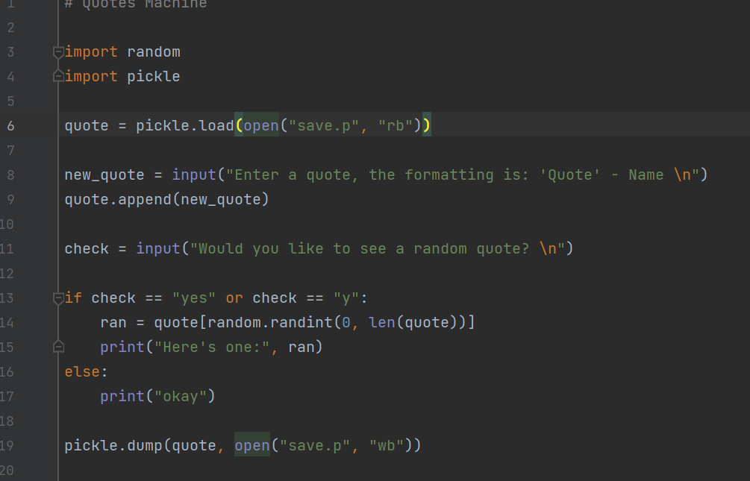
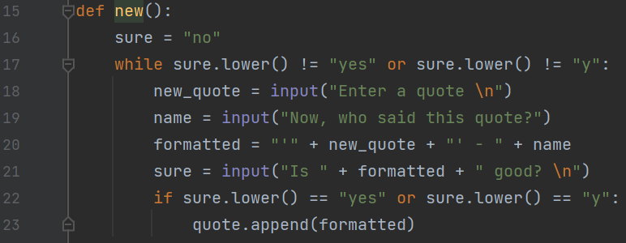
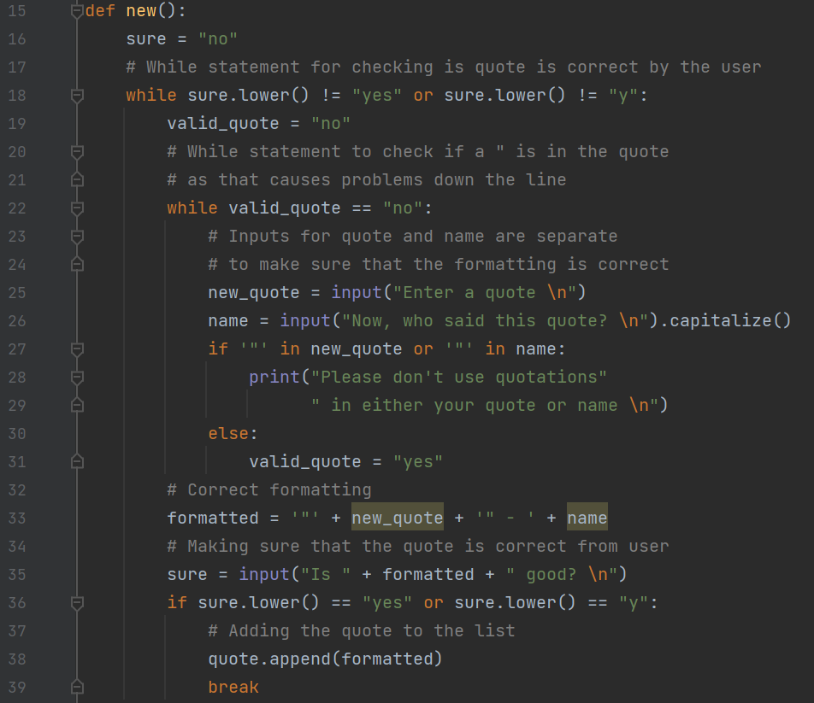
Trialling components: Adding Quotes
Above: Initial code to test pickling
Top Right: Correct formatting adding quote component with quotations problem
Right: Properly commented for clarity and quotations problem fixed (in red box)

Slide 11
Trialling components: Finding quotes by name
When initially making this component I decided to use regular expressions as a means to find quotes that someone had said by matching for any instance of a user input with a “-” added to the front. This worked however was tedious and was unnecessarily bug ridden. In order to fix this I decided to rather make a separate list containing any of the list items with the user input name. This was a much shorter and efficient process for my program to run and is important as and small optimations to my program will add up and it will become a much easier to read and run program. During this process I also decided to instead of search through a lowercase quotes list to find a lowercase user input I would instead capitalize the user input name for the quote when adding so that I could capitalize the user input in this component so that capitalization in the quotes weren’t lost. This improved the code as it made the code as a whole more consistent and provided a solution to a problem.

Slide 12
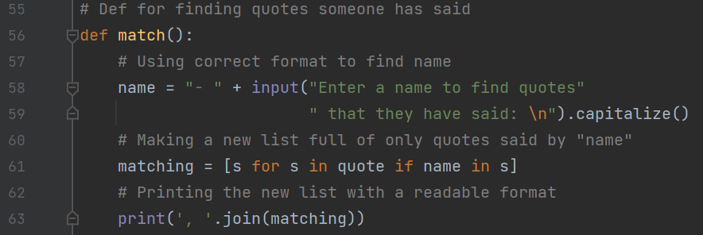
Trialling components: Finding quotes by name
Improved code with capitalization and using a new list for clearer and more efficient code.

Slide 13
Trialling components: Errors
Since multiple of my components required integer inputs in order to function correctly I needed a way to make sure a valid input was entered. My first solution to this problem was to make if statements to check if an input was a valid integer. This didn’t work because of an error popup which forcibly stopped the code from running that was named “ValueError”. The solution to this problem was in the try and except functions which handled this error in an efficient manner by using up little code and repeating the input so that the user may retry the input until they have entered a valid option.

Slide 14
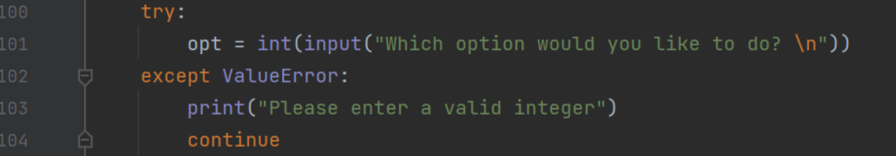
Trialing components: Errors

Slide 15
Trialling components:
When trialing all of my components I made sure that the text presented to the user was legible and made sense. This includes: Separating lines when necessary, correct wording to convey to the user in the most effective way what is required and to make sure that the program is in a formal tone as not to discourage the user from using my program. One way that I have improved this is that I’ve added a message before presenting the output of the code to the user so it is clear what the user is seeing

Slide 16
Testing outcome
When testing the outcome it’s important to test for every possible scenario. If you have an integer input what will happen if you inputted a decimal number or a negative number. If I had a yes or no input what would happen if the user inputted neither or one had spaces in them or it had capitals. Essentially I was intentionally trying to break my program and find the nooks and crannies left unpatched and that may cause problems. It was vital that I accounted for every single scenario possible as to make my program as robust as it possibly could be and that the end user did not run into any problems. However, since I am the creator of this program I may bias in some sort of way or may neglect a certain area. Getting feedback from someone who hasn’t worked on this project can solve this. I decided to give my program to Matthew Warn and he suggested something that I didn’t think of going through my program. He suggested that in the quote game he would like to see the correct answers to the question. When he was testing the program the game only displayed the final score as if it was a test or exam. This was a great addition as it provides a way to learn quotes in the program rather than never learning the at all. I would’ve never thought of adding this part of the component and having that outsider's perspective helped flesh out the program to a more capable one with more purpose and intent.

Slide 17
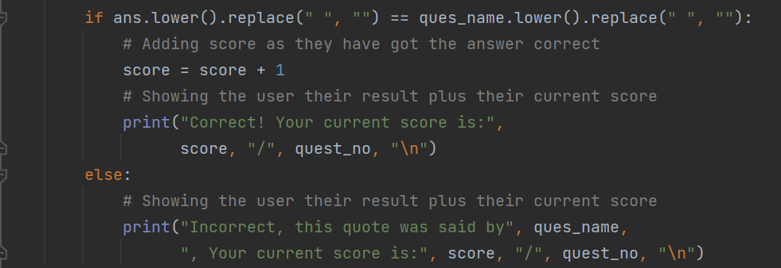
Testing outcome
Implemented change because of Matthew

Slide 18
Testing outcome
Another part of testing the outcome is using PEP8 to check for proper formatting throughout the code. Using PEP8 is considered good practice and makes the code more consistent to someone who isn’t familiar with code making it easier for them to read it. It is good for me to be in the habit of doing this early as in the future if I were to be collaborating on a project with a partner it is important for my code to be consistent with theirs and easier for them to understand. When checking PEP8 with my code the only errors were line length and unnecessary spaces at the end of lines or in the middle of code.

Slide 19
Relevant Implications: Legal
Compliance of the law is something that isn’t confined to just coding, it involves every aspect of our lives. It is important to produce a product which doesn’t steal information, break copyright law or displays any illegal activities to the user as failure to do will end up in a prosecution and the termination of your product. Probably the most important thing to note about my project is the fact that the content of the quotes is inputted by the users meaning that I have no control over what they put in. This means that the users may choose to put some sort of illegal quote in the machine. This may include but isn’t limited to: Hate Speech, the revealing of someone's personal information and links to illegal websites. However, my project runs on a device and isn’t set up to a server where I would have the responsibility to make sure that these ill intended quotes are filtered out of the system. Because it runs on a device it’s run locally and the inputted quotes are their responsibility as I am not letting them go by as I would be if they were inputted on a server because I can’t see them. This also covers such things as copyright laws as I am not distributing quotes or using them for a personal gain as it is all localised on the person's device.

Slide 20
Relevant Implications: Social and Cultural
It is important that you program can reach as many people as possible and to make sure that you are as inclusive as can be. In my program I believe I have achieved this. I maintain a formal and pleasant tone of voice throughout the program as not to shy away people from the program. My program, although being in english, allows the use of other languages in the quotes as to include quotes from other languages and cultures that people may want add. My program also doesn’t force and values or beliefs on the end user as to accommodate people from all different backgrounds. My intended audience for this program was everyone and the decisions I made in regards to its design and presentation have maintained this.

Slide 21
Relevant Implications: Functionality and Usability
It is important that the end user of my program has absolutely no problems with my code and that everything is logical. If the code wasn’t logical and was hard to use. I don’t want the end user to have a frustrating experience with my program and for that to be a barrier to using my program. The user shouldn’t need to encounter any bugs or errors as they aren’t the ones testing the program, they are the ones using the final product. I believe that I have achieved this by rigorously testing my program and accounting for every scenario in order to make sure that the end user won’t encounter any bugs and errors. I have also made sure that using the program is as clear and easy as it can be with it being text based and with a simple design in order to not overwhelm the user.

Slide 22
Relevant Implications: Sustainability and Future-Proofing
It is important for a program to be future-proof and sustainable as it provides a way for the program to react to the changes in technology and it makes it easy to make changes to the program without having to rewrite the entire program to accommodate the changes. I have made sure that this is possible with my menu system. It is easy to add another item to choose from in the menu and to potentially create submenus to navigate as the menu points to defs rather than housing the code inside of the menu. The inclusion of pickling also ensure that changing the code won't affect the saved quotes that are there.

Slide 23
Evaluate: Planning
Using the tools that I was most comfortable and capable with in the creation of this program greatly assisted me in creating a high quality product. Using tools such as pen and paper instead of an online alternative gave me the confidence to know what I was doing and to have a clear understanding of what I need to do in order to complete this program. The time aspect was also vital in making sure that I was doing the correct amount of work needed to complete this project and it took a load off of my back by making sure that I don’t get caught up on time later on in the project. Setting up the version control system also helped greatly in making sure I was never completely lost in the creation of this project so I could more effectively analyse what needs to be done to make my project the highest quality that it can be.

Slide 24
Evaluate: Trialing of Components
When trialing the components of my project I always made sure I put in effort to find the most efficient and effective way to accomplish a components task. This was most clearly seen in the finding of quotes said by someone where cleaned up a messy use of regular expressions to one line of code that accomplished the same task more efficiently and in less lines of code. This ensured that my program was the most polished it could be and the highest quality it could be. This was not only limited to the code itself but also the presentation of it. I made sure that what the user was shown was the most logical way it could be presented. This was accomplished by using numberings for options, clearly asking the user for what they are required to input for when it is required and using a simple text interface as not to clutter the users screen with unnecessary information. This my social, cultural, functionality and usability parts of my implications and I always made sure to address them so that my program was the highest quality it could possibly be.

Slide 25
Evaluate: Testing
I found that testing was the most important part of developing my product. My product may have achieved all of the features that it set out to do but how could the user use them if the program has many bugs and the user has to tread carefully or they may break the program. To combat this I thoroughly test the program for every case scenario that the user may end up doing. Using this I managed to find and iron out any problems that were left in the program. Not only that I also further improved my product by getting people with an outsider's perspective on my program to test it which further opened my eyes to improvements that could be made in order to make a higher quality product. Finally to ensure that the code is up to standard with the rest of the coding world I used PEP8 to make sure that my code was consistent and readable in order to create the highest quality product possible.

